Slide 1

Airtraffic system UML Colloquium
Presented by Team 1
Atanasova, Antoniya - 03648938
Lee, Alice - 03281160
Petrov, Ivan - 03648235
Rudert, Katherina - 03648166
Murugesh, Rishigesh - 03636607
Streitweiser, Benedikt - 03623651

Slide 2
Agenda
UML data model overview
UML workflow – Booking a flight
Sequence diagrams

Slide 3

UML data model class diagram
Migration process included
Identifying the core entities and reducing their number up to 16-17?
Migrating the ERM model into UML class diagram with the entities from step1
Class diagram overview

Slide 4
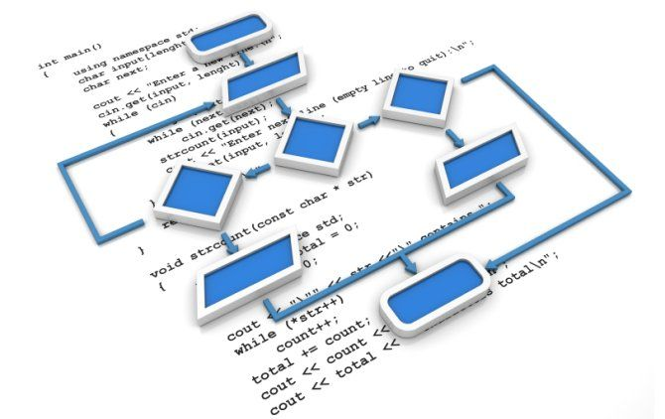
UML workflow diagram
Workflow scope – Booking a flight through air traffic database management system
Activity diagram overview

Slide 5
UML sequence diagrams
Passenger
Airport
Airline
Sequence diagrams overview

Slide 6

Thank You!

